Slide 1

POLYP SEGMENTATION USING DEEP LEARNING
Presented by,
NIMITHA GOPINATH
Student ID: 301459904

Slide 2
POLYP
Cancerous
Tissue that grows on the colon
Colonoscopy - procedure for the identification, localization, and removal of polyps
Colorectal polyps are often missed by the clinicians during colonoscopy
How can we identify polyps? - Semantic segmentation.
Non-Cancerous

Slide 3
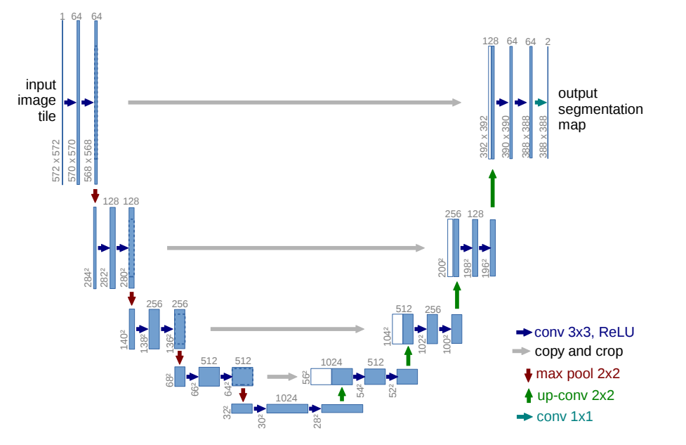
U-NET
Two parts:
Encoder
Decoder
https://lmb.informatik.uni-freiburg.de/people/ronneber/u-net/

Slide 4
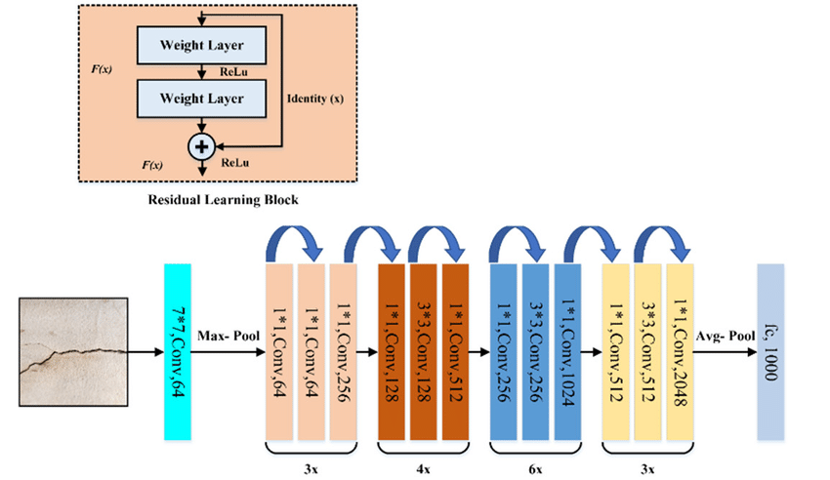
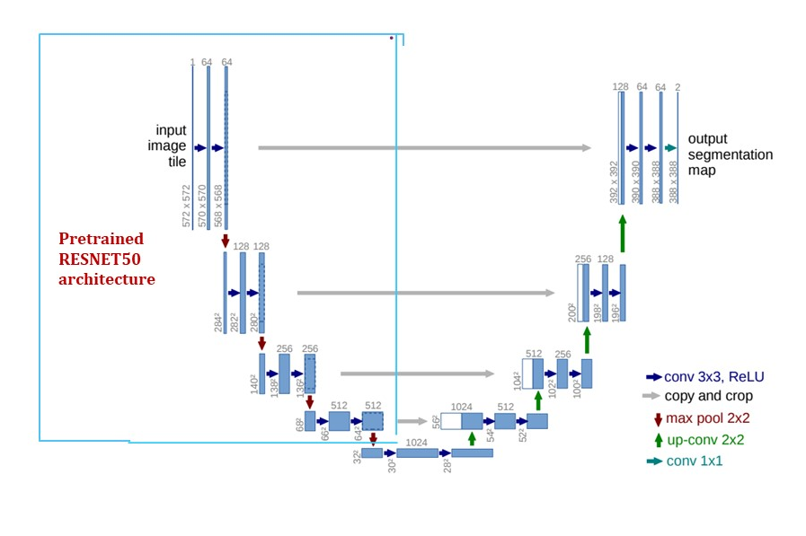
Modified U-Net
https://www.researchgate.net/figure/The-architecture-of-ResNet-50-model_fig4_349717475

Slide 5
Architectures used in the project
Simple U-Net architecture
U-Net with pre-trained ResNet50 as the encoder
Comparison and Analysis

Slide 6
DATASET
CVC-ClinicDB - official database to be used in the training stages of MICCAI Sub-Challenge on Automatic Polyp Detection Challenge in Colonoscopy Videos
 | Images | Masks
Total number | 612 | 612
Color | RGB | Greyscale
Size | 256x256 | 256x256
Test set | 61 | 61
Validation set | 61 | 61
Training set | 490 | 490

Slide 7
INPUT IMAGES AND MASKS (Samples)
https://polyp.grand-challenge.org/CVCClinicDB/

Slide 8
ARCHITECTURE 1
Simple U-Net

Slide 9
Step 1: Data | 1)Load dataset, split into training, validation, test set 2) Read the image and the mask 3) Setting up tf.data pipeline for the training
Step 2: Model developing | Building encoder - Filter size is taken as 16, 32, 48, 64 Bridge Decoder Output layer
Step 3: Training of the model | Loading the training and validation dataset 2) Setting up tf.data pipeline for training and validation dataset 3) Setting up hyperparameters Batch =8 Learning rate = 10⁻⁴ Epochs = 20 4) Building U-Net model 5) Defining loss, optimiser, and metrics Loss: binary crossentropy Optimizer: Adam 6) Defining callbacks 7) Start the training
Step 4: Testing of the model | Loading the testing dataset 2) Setting up the tf.data pipeline for testing dataset 3) Loading the training U-Net model 4) Make the prediction and save the result

Slide 10
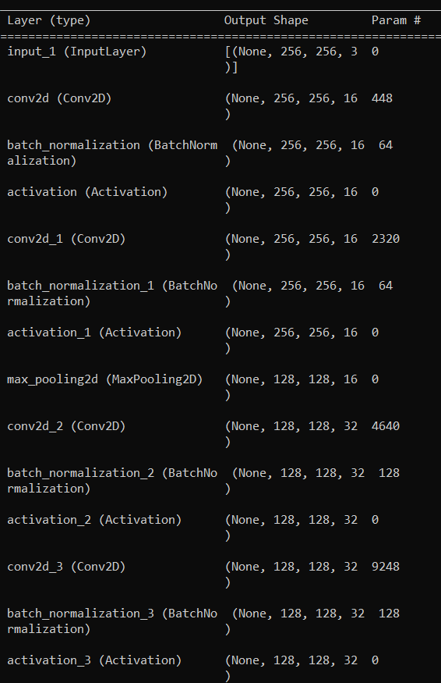
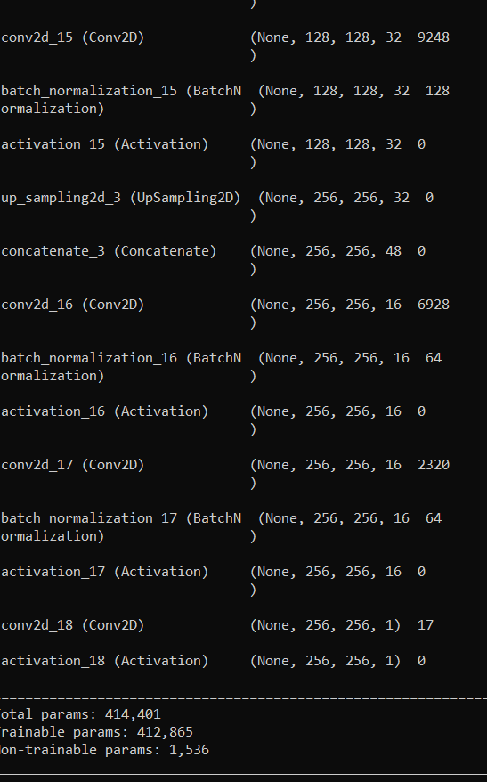
Model parameters (Step 2):

Slide 11
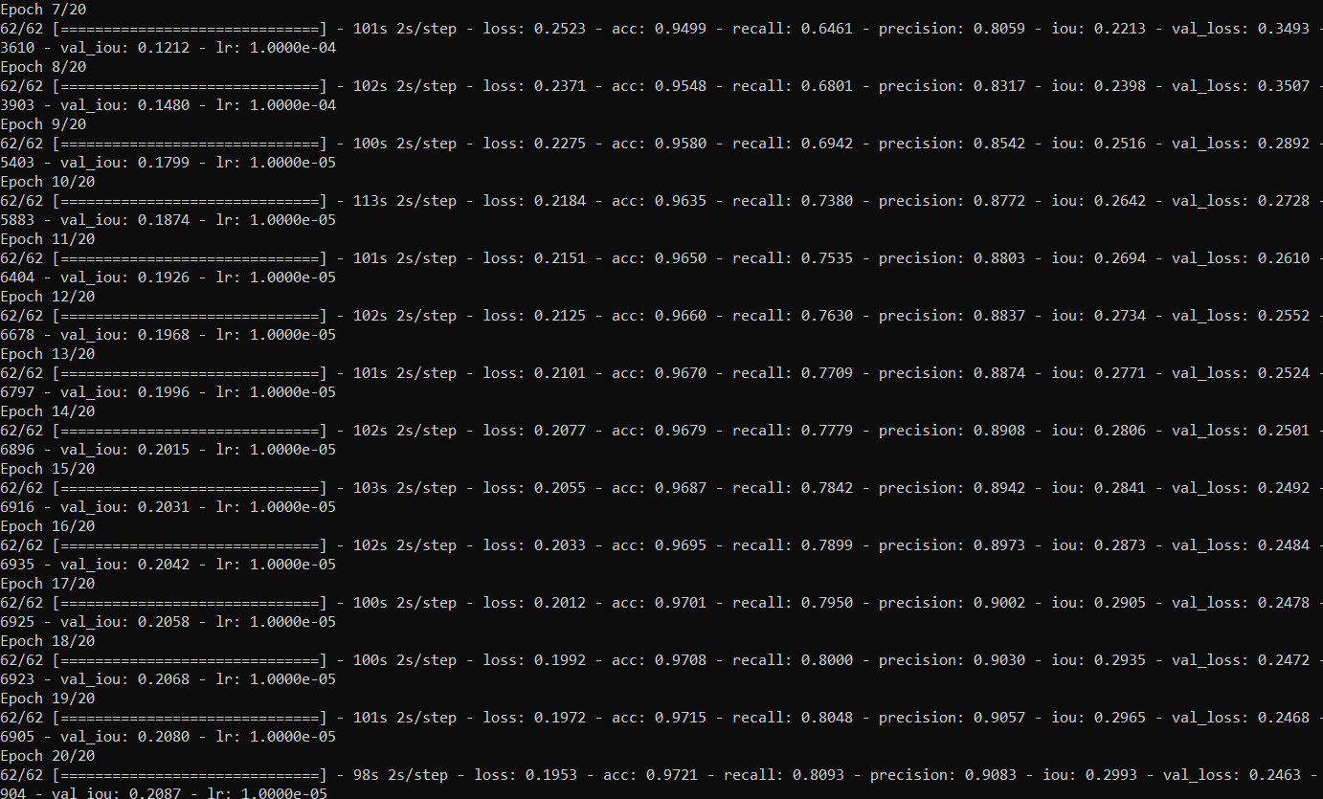


Training output (Step 3):
Accuracy = 0.9721
Validation loss = 0.2463

Slide 12

Tested output (Step 4):
Accuracy = 0.9338

Slide 13
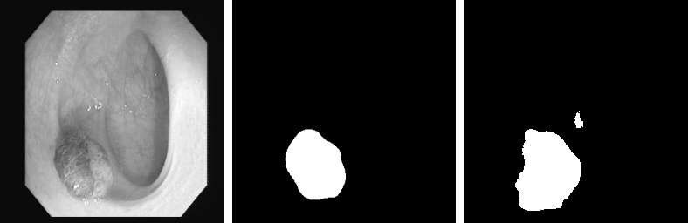
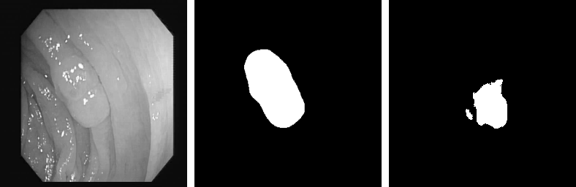
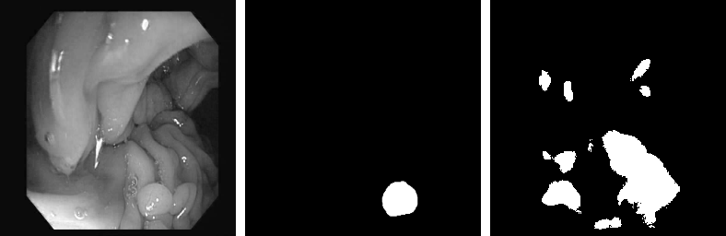
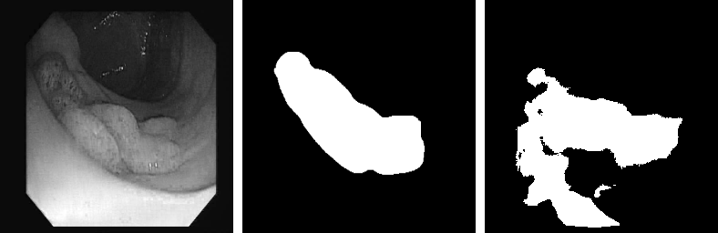
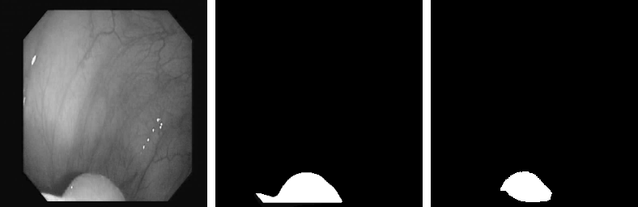
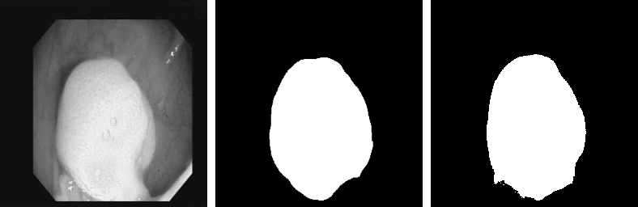
OUTPUT IMAGES

Slide 14
ARCHITECTURE 2
Modified U-Net

Slide 15
Step 1: Data | 1)Load dataset, split into training, validation, test set 2) Read the image and the mask 3) Setting up tf.data pipeline for the training
Step 2: Model developing | 1) Called the Predefined ResNet50 function and build encoder using that built Bridge 2)Built Decoder 3) Output layer
Step 3: Training of the model | Loading the training and validation dataset Setting up tf.data pipeline for training and validation dataset Setting up hyperparameters Batch =8 Learning rate = 10⁻⁴ Epochs = 20 4) Building U-Net model 5) Defining loss, optimiser, and metrics Loss: binary crossentropy Optimizer: Adam Defining callbacks Start the training
Step 4: Testing of the model | Loading the testing dataset, Setting up the tf.data pipeline for testing dataset Loading the training U-Net model, Make the prediction and save the result

Slide 16
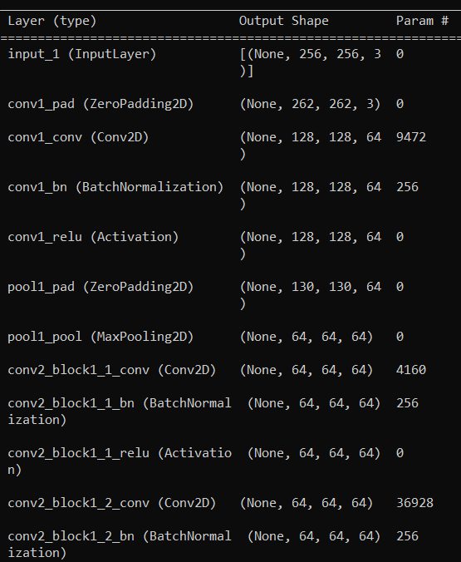
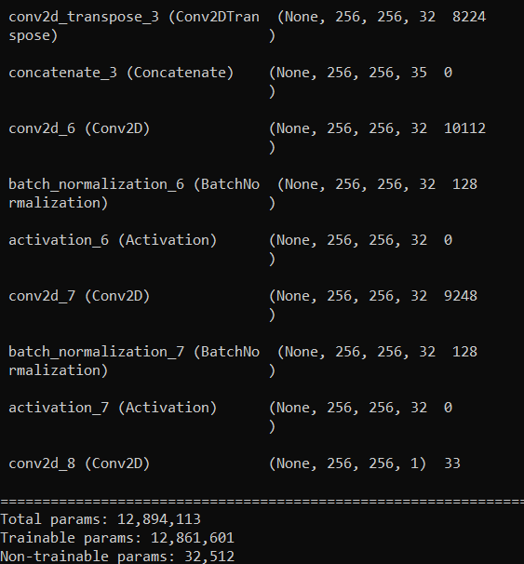
Model parameters (Step 2):

Slide 17
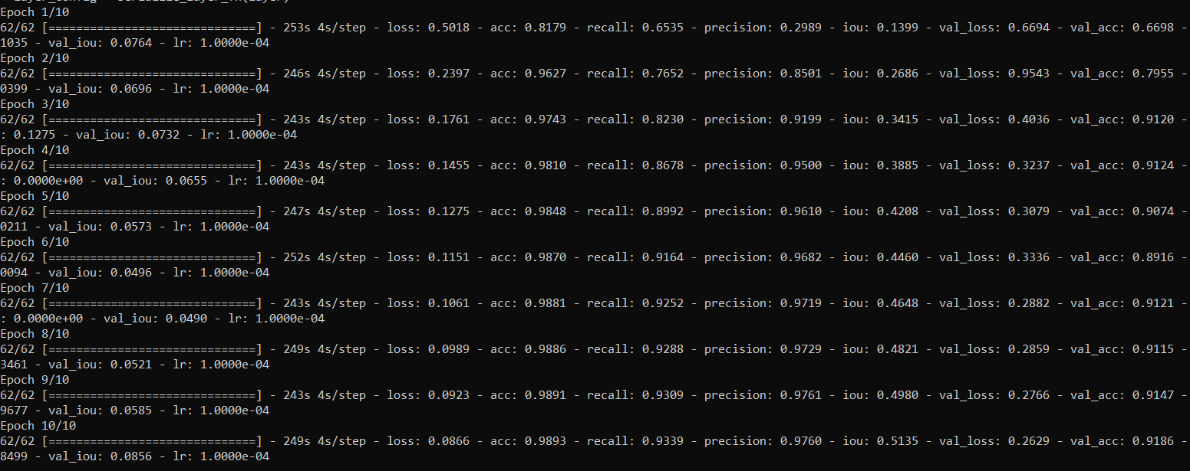


Training output (Step 3):
Accuracy = 0.9893
Validation loss = 0.2629

Slide 18

Tested output (Step 4):
Accuracy = 0.9078

Slide 19
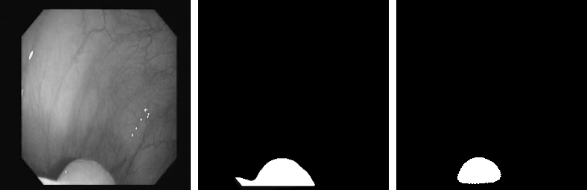
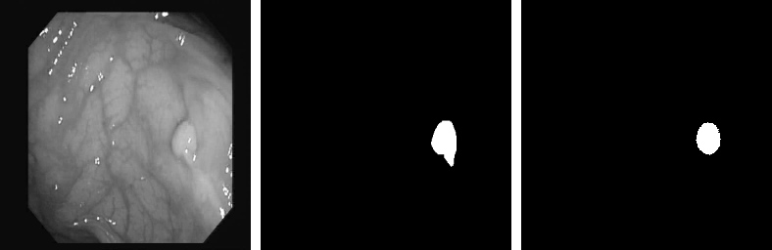
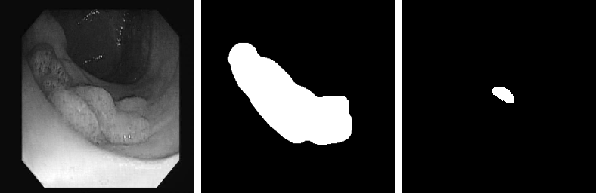
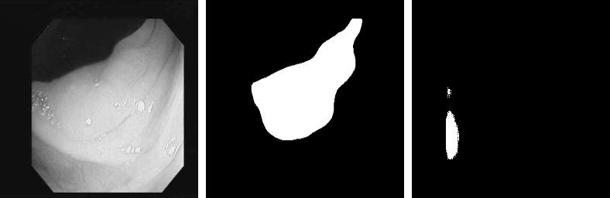
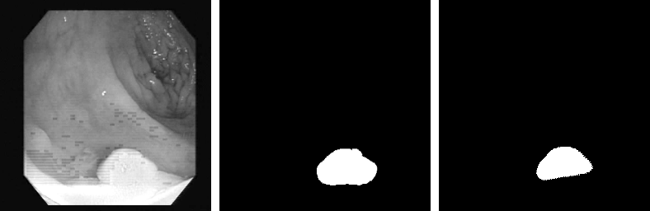
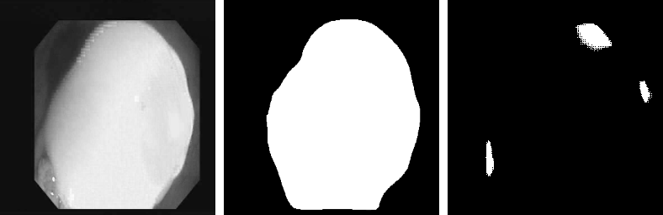
OUTPUT IMAGES

Slide 20
ACCURACY COMPARISON – Training data
Epoch | U-Net | Resnet50- UNet
10 | 0.9542 | 0.9893
20 | 0.9721 | 0.9912
ACCURACY COMPARISON – Testing data
Epoch | U-Net | Resnet50- UNet
10 | 0.9162 | 0.9078
20 | 0.9338 | 0.9705

Slide 21
CONCLUSION
Polyp segmentation performed using U-Net and Resnet50-Unet was performed
After one trail for training data, Resnet 50-Unet is better
For testing data, U-Net is better

Slide 22
REFERENCES
[1] https://arxiv.org/pdf/1505.04597.pdf
[2] https://medium.com/analytics-vidhya/deep-learning-image-segmentation-and-localization-u-net-architecture-ea4cff5595d9
[3] https://www.analyticsvidhya.com/blog/2021/08/all-you-need-to-know-about-skip-connections/
[4] https://lmb.informatik.uni-freiburg.de/people/ronneber/u-net/
[5] https://developers.arcgis.com/python/guide/how-unet-works/
[6] Saruar Alam1 , Nikhil Kumar Tomar2 , Aarati Thakur3 , Debesh Jha2,4, Ashish Rauniyar5,6, “Automatic Polyp Segmentation using U-Net-ResNet50”, MediaEval’20, December 14-15 2020, Online
[7] Zhengxin Zhang† , Qingjie Liu†∗ and Yunhong Wang, Senior, “Road Extraction by Deep Residual U-Net”, IEEE GEOSCIENCE AND REMOTE SENSING LETTERS
[8] Slides by Prof Ivan Bajic

Slide 23
THANK YOU

